Slide 1
SQL Injection Technique
64,69,85,101,117,131

Slide 2
SQL Injection
SQL injection is a code injection technique that might destroy your database.
SQL injection is the most common web hacking techniques.
SQL injection is the placement of malicious code in SQL statements, via web page input

Slide 3
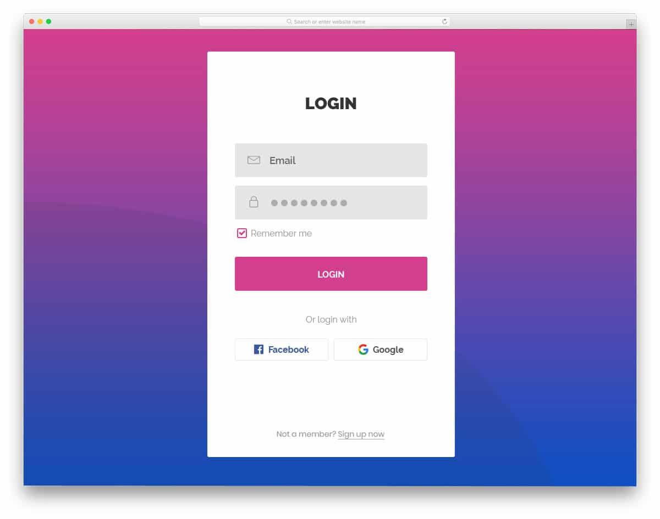
Web Form

Slide 4
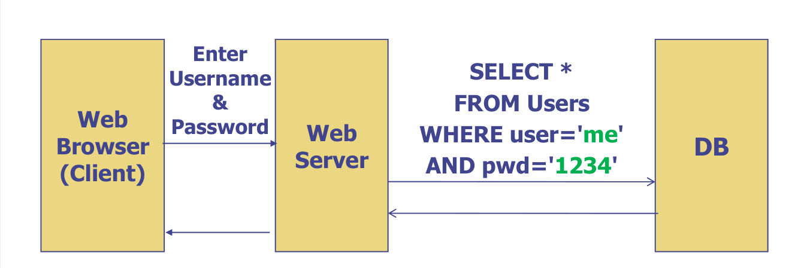
Normal Query

Slide 5
SQL in Web Pages
SQL injection usually occurs when you ask a user for input, like their username/userid, and instead of a name/id, the user gives you an SQL statement that you will unknowingly run on your database.
Look at the following example which creates a SELECT statement by adding a variable (txtUserId) to a select string. The variable is fetched from user input (getRequestString):
Example:
txtUserId= getRequestString(“UserId”)
txtSQL = “SELECT * FROM Users WHERE UserId= “ + txtUserId

Slide 6
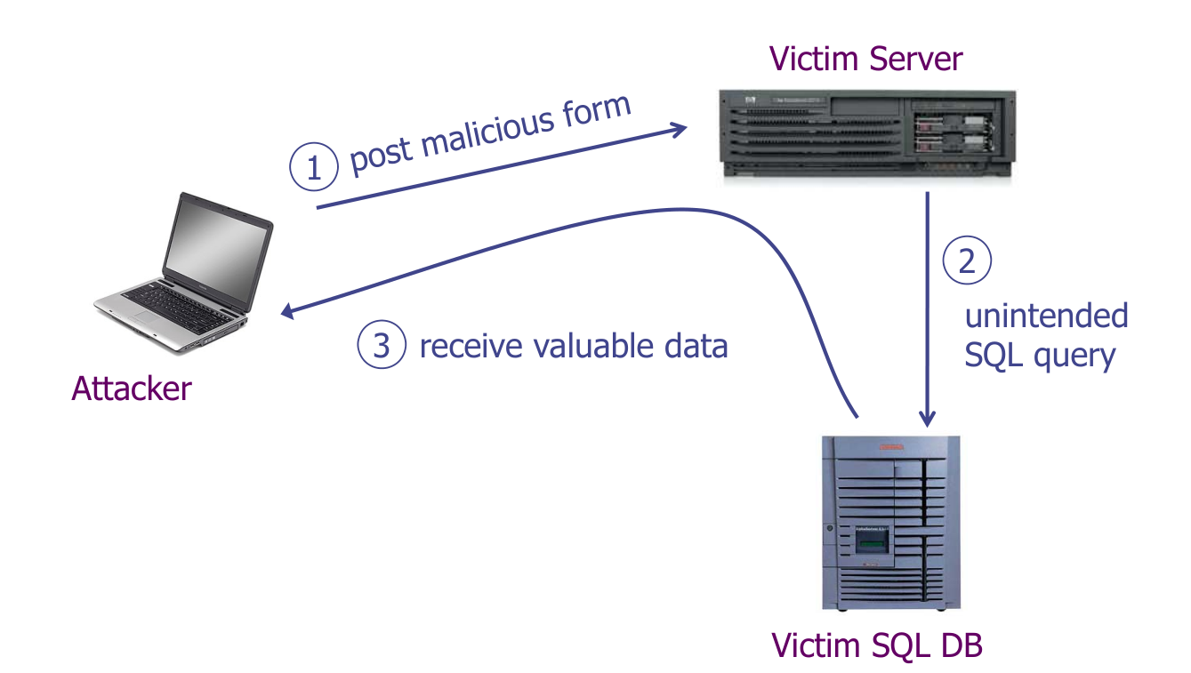

Slide 7
DEMO
https://hacksplaining.com/lessons/sql-injection

Slide 8
Preventing SQLi
Never build SQL commands yourself
Use Parameterized/prepared SQL
Use ORM framework
The application should never use the input directly. The developer must sanitize all the inputs, not only on the web form inputs like login forms.
It is a good idea to turn off visibility of database errors on your production sites.

Slide 9
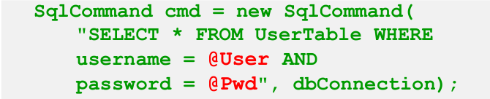
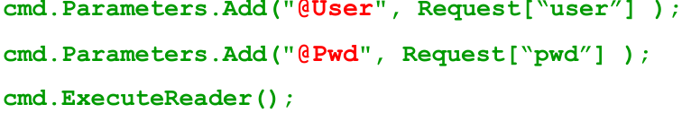
Parameterized/prepared SQL
Build SQL using properly escaping args: ‘-> \ ’
Example: Parameterized SQL:
Ensures SQL arguments are properly escaped.

Slide 10
ORM Framework (Object Relational Mapping)
Allows interaction with databases using object-oriented programming paradigms instead of raw SQL queries.
Maps classes (objects in code) to database tables, columns to object attributes, and rows to instances of the class.
Example: ORM Framework:
class User(models.Model):
username = models.CharField(max_length=50)
password = models.CharField(max_length=50)
user = User.objects.filter(username='example_user').first()

Slide 11
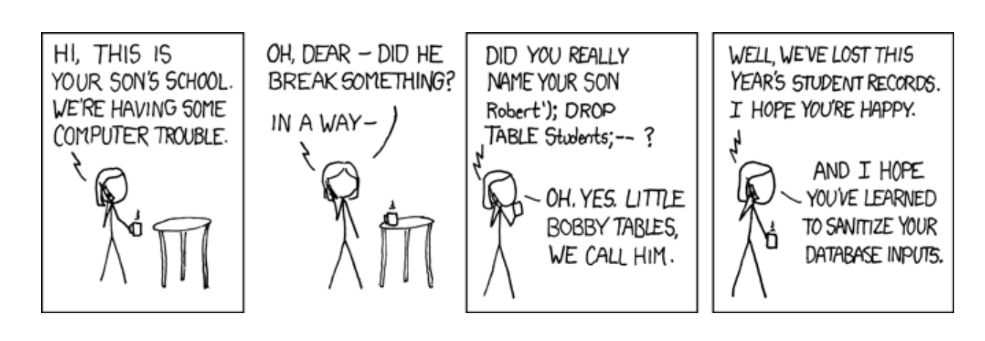

Slide 12
THANK YOU

